Slide 1
Fantasy Tour Dé France

Slide 2
Picking a winning team

Slide 3
Rules
Pick (exactly) 9 riders
Each rider costs a fixed number of points
Team must cost <= 100 points
Must pick 2 All-Rounders, 2 Climbers, 1 Sprinter, 3 Unclassed Riders and 1 Wild Card
No team changes/substitutions after Tour starts
Scoring is based on stages and various other points each rider can collect along the course of the race
The winning (fantasy) team is not necessarily composed of the riders who came 1st-9th.
https://www.velogames.com/tour-de-france/2017/rules.php

Slide 4
Goals
Come up with 3-4 team suggestions
Secretly enter the fantasy league
…..
Bragging rights

Slide 5
Collect the Data
Notes:
Talk about how the command phase is structured

Slide 6
Gather Rider Data
Data to Collect
For every available rider choice in 2017:
Previous year(s) costs, scores and categories
2017 cost and category
Notes:
Talk about how the command phase is structured

Slide 7
Riders breakdown
Christopher Froome | Team Sky | 26 Points
Richie Porte | BMC Racing Team | 22 Points
….
191 Total Riders
Notes:
Talk about how the command phase is structured

Slide 8
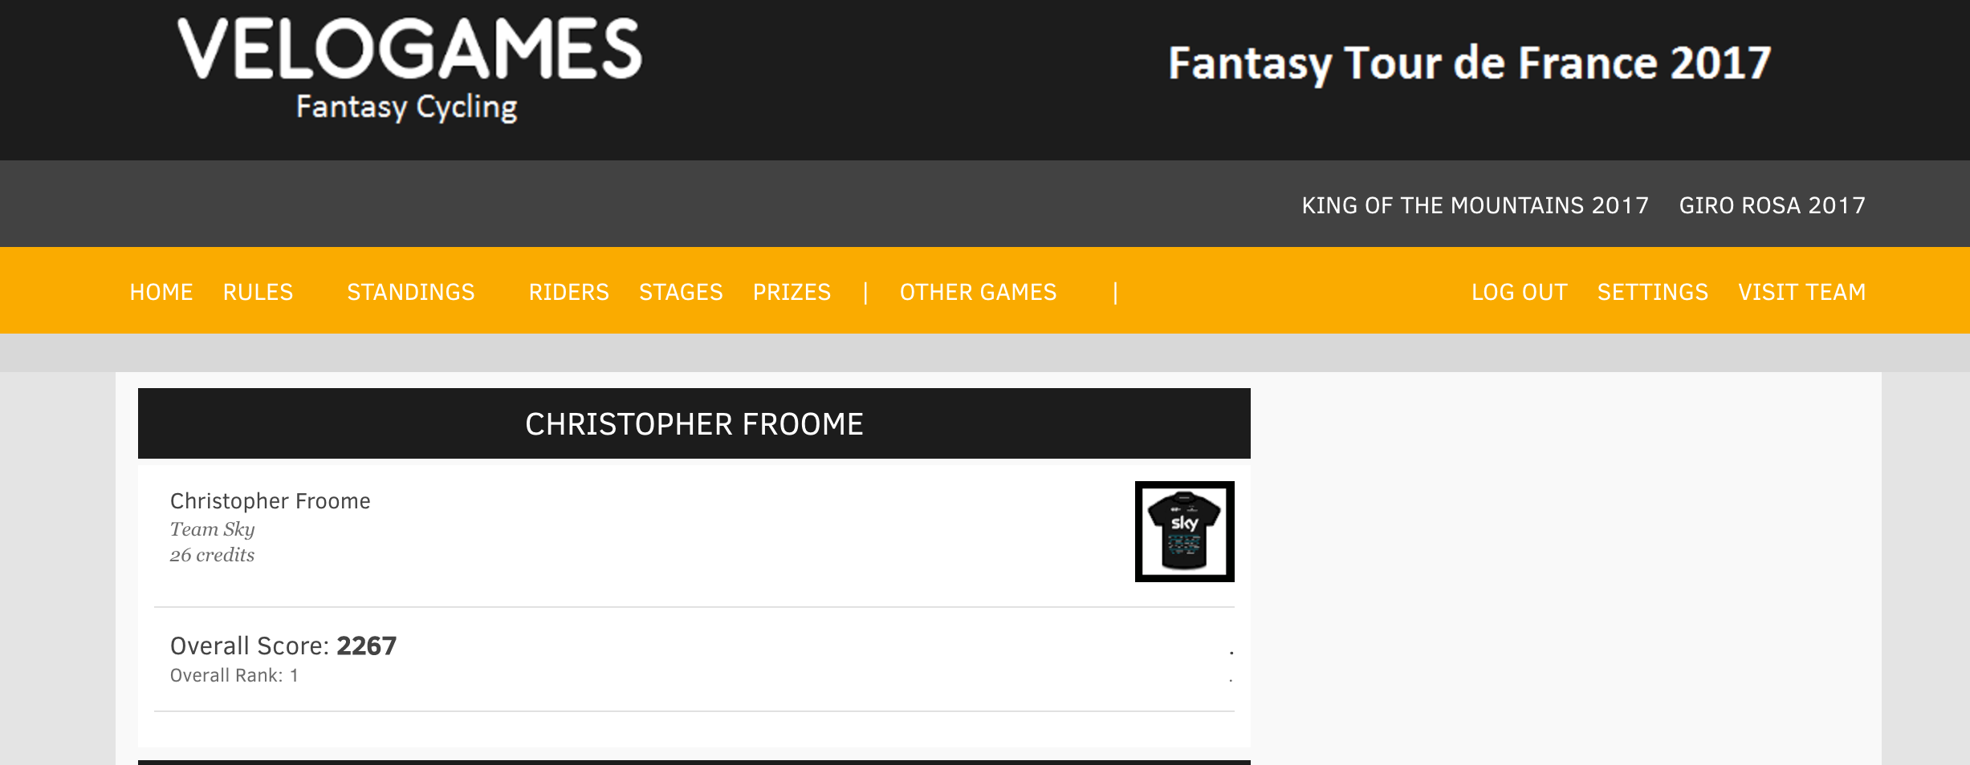
Rider breakdown
Notes:
Talk about how the command phase is structured

Slide 9
Data Gathering Complications
Each rider’s cost and past performance live in separate web pages
Previous year web pages are in different formats
Some pages are behind a login (annoying cookie/auth issues)
Notes:
Talk about how the command phase is structured

Slide 10
Data Gathering Solution
mechanize & beautifulSoup4
Notes:
Talk about how the command phase is structured

Slide 11
Data Gathering Solution
br = mechanize.Browser()
br.set_handle_robots(False) # ignore robots.txt
br.addheaders = [("User-agent","Mozilla/5.0")] # pretend to be mozilla
response = br.open(all_players) # get the markup for the all players page
assert response.code == 200 # make sure good things happened
Notes:
Talk about how the command phase is structured

Slide 12
Data Gathering Solution
# get all the links for each riders page
soup = BeautifulSoup(response.read(), 'html.parser')
# list of (url, name) for each rider's data
player_links = [link.get('href'), link.getText() for link in
soup.find_all('a') if 'riderprofile.php' in link.get('href')]
Notes:
Talk about how the command phase is structured

Slide 13
Data Gathering Solution
# iterate over every player’s data page, dump data into a csv
# go to each player’s page and retrieve all the stage stats
for (player_link, player_name) in player_links:
response = br.open(player_base + player_link)
soup = BeautifulSoup(response.read(), 'html.parser')
for tr in soup.find_all('tr'):
row = player_name + ',' + year + ','
for td in tr.find_all('td'):
row += td.getText().strip('\r\n') + ','
print row.encode('ascii', 'ignore')
Notes:
Talk about how the command phase is structured

Slide 14
Final Raw Data Sets
random_code/velobet (master) $ head player_2017.csv.bak | column -s ',' -t
Category Cost Name Team
All Rounder 1 26 Christopher Froome Team Sky
All Rounder 1 22 Richie Porte BMC Racing Team
All Rounder 1 16 Alberto Contador Trek - Segafredo
All Rounder 1 16 Alejandro Valverde Movistar Team
All Rounder 1 14 Thibaut Pinot FDJ
All Rounder 1 12 Geraint Thomas Team Sky
All Rounder 1 10 Andrey Amador Movistar Team
All Rounder 1 10 Ion Izagirre Bahrain Merida Pro Cycling Team
All Rounder 1 10 Diego Ulissi UAE Team Emirates
...
Notes:
Describe the structure of a mysql packet
Its a bunch of binary, the first 24 bits describe a little int (<-talk about difference between big and little)
The next one is a sequence id (<-how the client maintains state)

Slide 15
Final Raw Data Sets
random_code/velobet (master) $ head player_2014.csv.bak | column -s ',' -t
PlayerName Year Stage STG GC PC KOM SPR SUM BKY ASS Total
Vincenzo Nibali 2014 Stage 1 - - - - - - - - 0
Vincenzo Nibali 2014 Stage 2 150 25 2 - - - - 4 181
Vincenzo Nibali 2014 Stage 3 - 25 - - - - - 4 29
Vincenzo Nibali 2014 Stage 4 - 25 - - - - - 4 29
Vincenzo Nibali 2014 Stage 5 100 25 2 - - - - 14 141
Vincenzo Nibali 2014 Stage 6 - 25 - - - - - 10 35
Vincenzo Nibali 2014 Stage 7 - 25 - - - - - 10 35
Vincenzo Nibali 2014 Stage 8 100 25 - - - - - 10 135
Vincenzo Nibali 2014 Stage 9 - 22 - - - - - 6 28
...
Notes:
Describe the structure of a mysql packet
Its a bunch of binary, the first 24 bits describe a little int (<-talk about difference between big and little)
The next one is a sequence id (<-how the client maintains state)

Slide 16
Build The Model
Notes:
Talk about how the command phase is structured

Slide 17
Model - v1
Look at all the possible team combinations in the past that
cost <= 100 points
satisfy the category requirements
For each team_combination
compute the final score the team would have scored in that year
Choose the historically highest scoring teams for each year
Notes:
Talk about how the command phase is structured

Slide 18
Model - v1 problems
wc -l cost_combinations.csv
1530652 cost_combinations.csv
There are ~1.5 Million combinations of costs that total <= 100 points. Combined with 191 Players, this is around ~400 Billion potential teams combinations to sort through.
Notes:
Talk about how the command phase is structured

Slide 19
Model - v2
The same model idea - optimize the number of teams to sort through by reducing the total number of combinations.
Notes:
Talk about how the command phase is structured

Slide 20
Model - v2
Start with a cost combo
26,16,4,6,4,4,8,8,4,80
This is a combination of costs that is <= 100 points and satisfies the category requirements (each column is the required category - last column is total of the columns to the left).
Notes:
Talk about how the command phase is structured

Slide 21
Model - v2
With the current cost combo (26,16,4,6,4,4,8,8,4,80)
Produce all player combinations that match that cost
Multiple players can have the same cost (use python set() ‘s to collect unique combinations)
use the python yield construct for faster performance
From the given potential players, choose the highest scoring players - create a team with these players.
Notes:
Talk about how the command phase is structured

Slide 22
Model - v2
def get_player_combinations(headers, cost_combo, cost_map, historical_scores):
# …
for combo in bucket_combo(best_avail_players):
sc = set(combo)
# don’t waste time checking invalid combos
if len(combo) != len(sc):
continue
yield combo
Notes:
Talk about how the command phase is structured

Slide 23
Model - v2
def bucket_combo(l, depth=0) :
''' return all combinations of items in buckets '''
for item in l[0] :
if len(l) > 1 :
for result in bucket_combo(l[1:], depth+1) :
yield [item,] + result
else :
yield [item,]
Notes:
Talk about how the command phase is structured

Slide 24
Model - v2
Tweaking the algorithm results in
Load all 1.5M cost combinations into an indexed map: ~30s
Generate the best team for each cost combination for each year individually, and average for all 3 years:
~180s
Notes:
Talk about how the command phase is structured

Slide 25
Results
 | All Rounder 1 | All Rounder 2 | Unclassed Rider 1 | Sprinter 1 | Unclassed Rider 3 | Unclassed Rider 2 | Climber 2 | Climber 1 | Wildcard Rider | Cost | Score 2014 | Score 2015 | Score 2016
Best Average | Bauke Mollema | Alejandro Valverde | Greg Van Avermaet | Alexander Kristoff | Imanol Erviti | Zdenek Stybar | Serge Pauwels | Nairo Quintana | Peter Sagan | 100 | 7190 | 7484 | 7845
Best 2016 | Robert Gesink | Thibaut Pinot | Dmitriy Gruzdev | Alexander Kristoff | Thomas De Gendt | Laurens Ten Dam | Rafal Majka | Nairo Quintana | Peter Sagan | 100 | 6429 | 6472 | 8010
Best 2015 | Robert Gesink | Alejandro Valverde | Greg Van Avermaet | John Degenkolb | Tony Gallopin | Imanol Erviti | Serge Pauwels | Nairo Quintana | Peter Sagan | 100 | 6524 | 8763 | 6507
Best 2014 | Robert Gesink | Bauke Mollema | Jarlinson Pantano | Mark Cavendish | Greg Van Avermaet | Thomas De Gendt | Daniel Martin | Romain Bardet | Peter Sagan | 98 | 8739 | 6824 | 6372
Notes:
Talk about how the command phase is structured

Slide 26
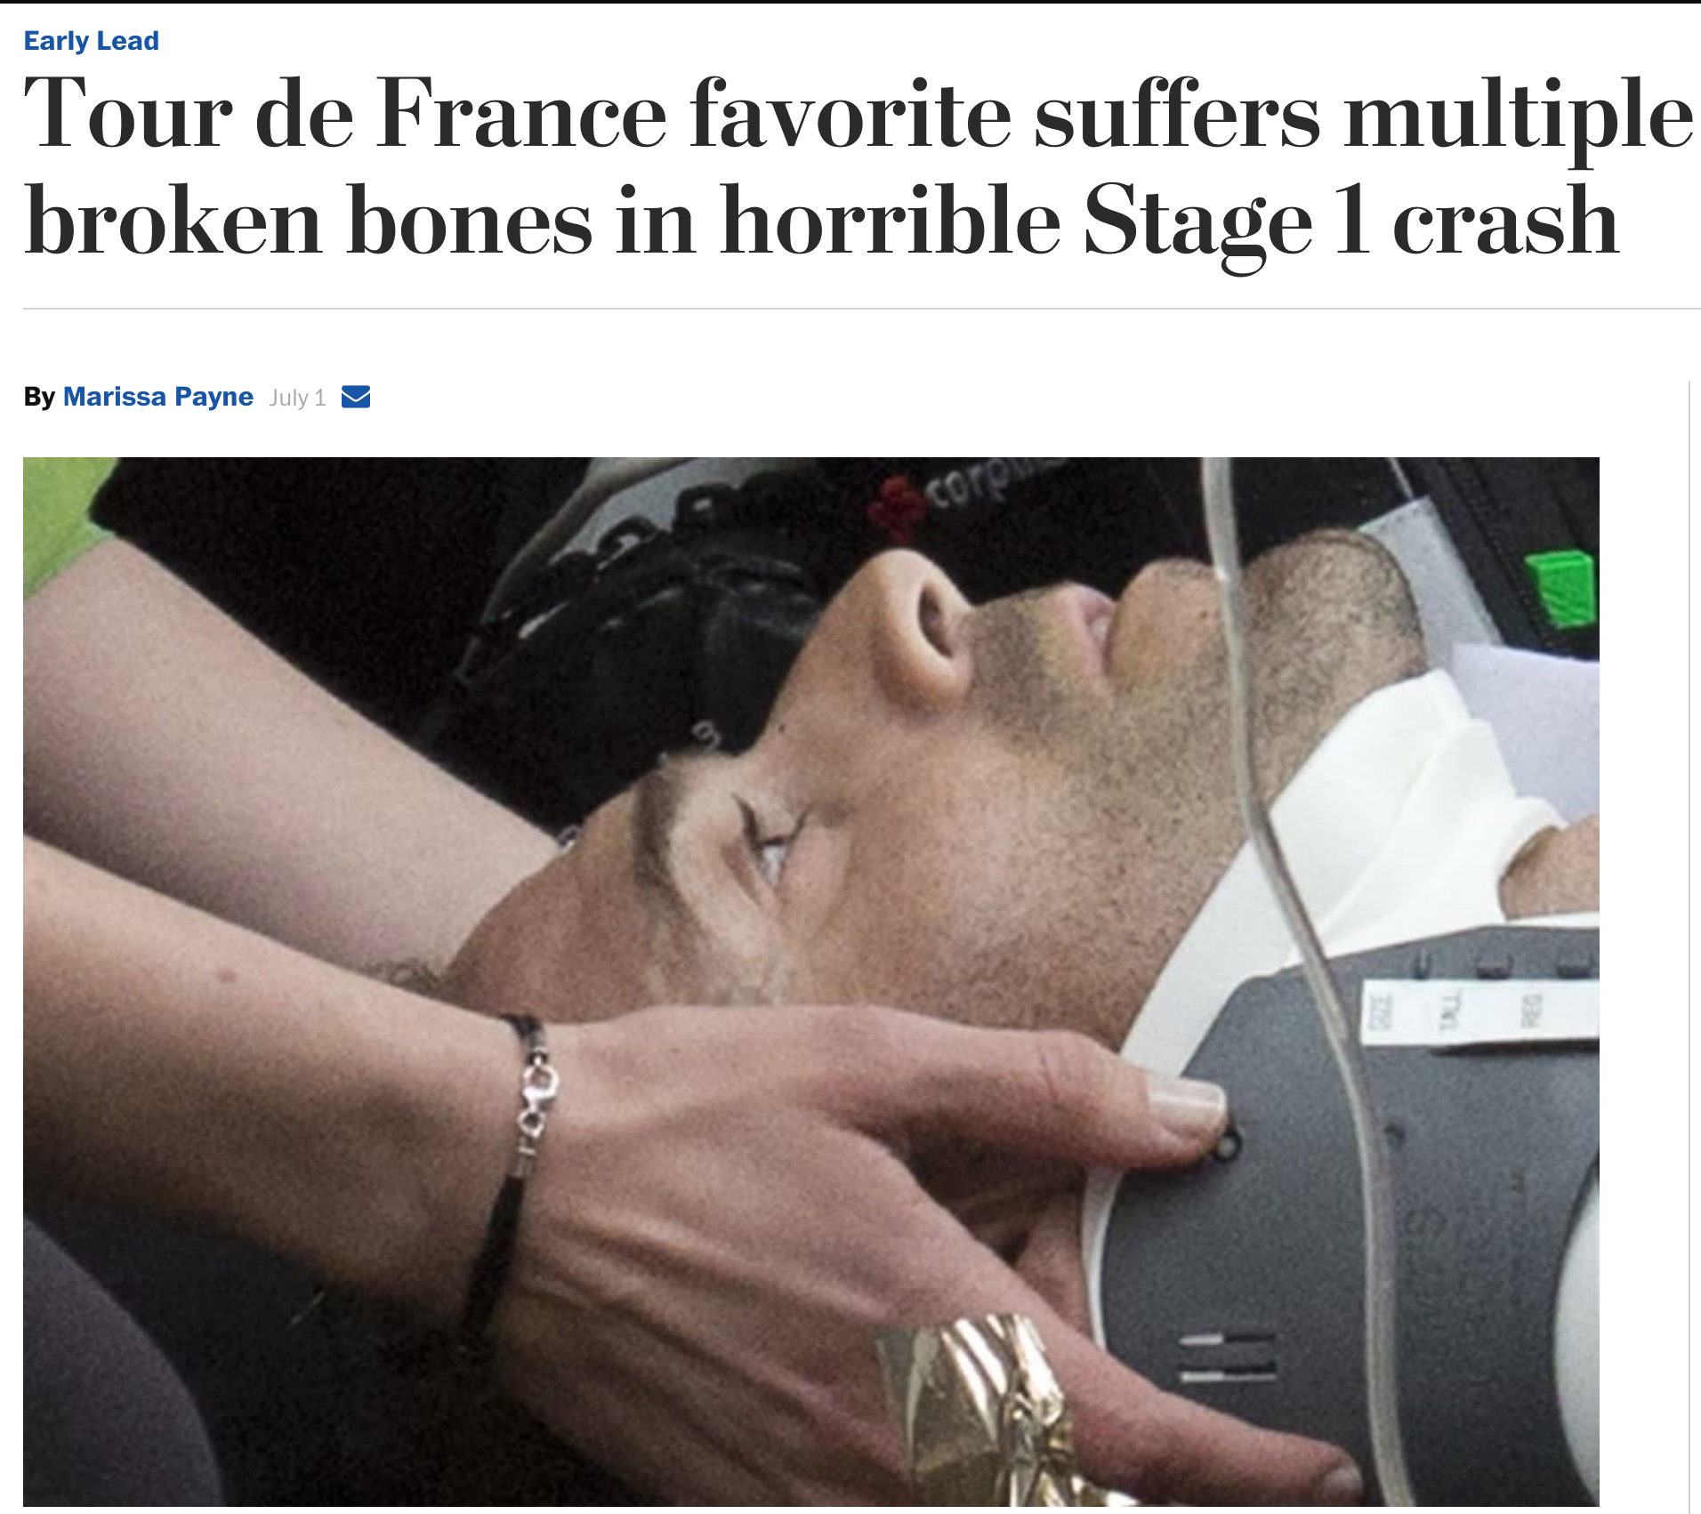
Actual Results - Day 1
Notes:
Talk about how the command phase is structured

Slide 27
Actual Results - Day 1
Notes:
Talk about how the command phase is structured

Slide 28
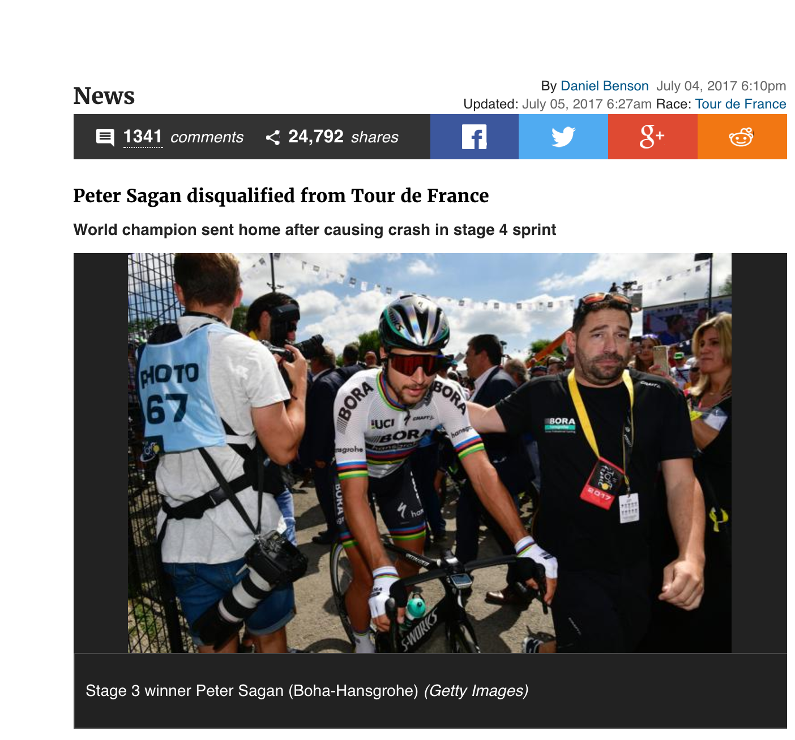
Actual Results - Day 3
Notes:
Talk about how the command phase is structured

Slide 29
Actual Results - Day 17
Notes:
Talk about how the command phase is structured

Slide 30
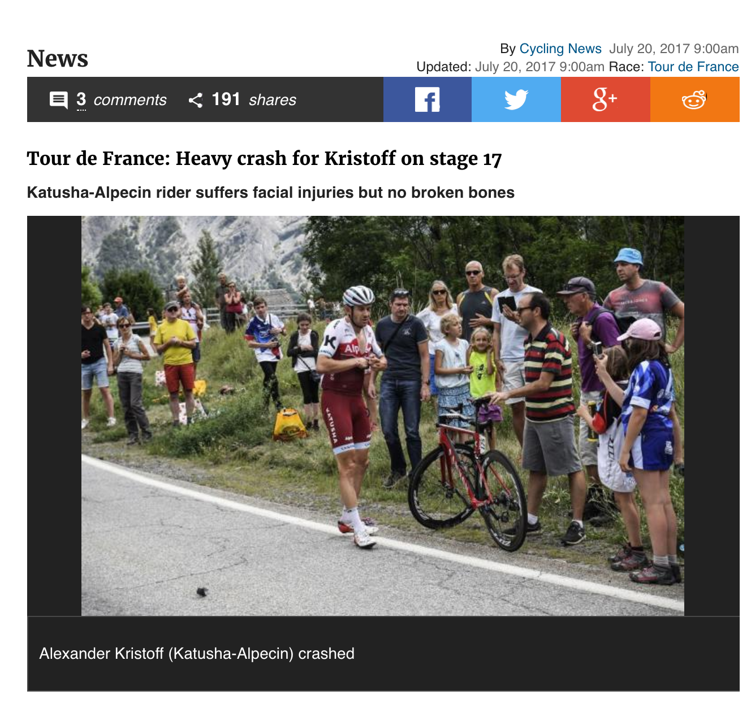
Actual Results - Day 17
Notes:
Talk about how the command phase is structured

Slide 31
Actual Results - Day 3
Notes:
Talk about how the command phase is structured

Slide 32
Final Results
15th place
Notes:
Talk about how the command phase is structured

Slide 33
Final Results
Out of 19.
Notes:
Talk about how the command phase is structured

